Slide 1
Exception Handling
An exception is an error that occurs at run time.
Using Java’s exception handling subsystem you can, in a structured and controlled manner, handle run-time errors.
Although most modern programming languages offer some form of exception handling,
Java’s support for it is both easy-to-use and flexible.

Slide 2
Exception Handling
Exception handling streamlines error handling by allowing your program to define a block of code, called an exception handler, that is executed automatically when an error occurs.
It is not necessary to manually check the success or failure of each specific operation or method call.
If an error occurs, it will be processed by the exception handler.

Slide 3
The Exception Hierarchy
In Java, all exceptions are represented by classes. All exception classes are derived from a class called Throwable.
Thus, when an exception occurs in a program, an object of some type of exception class is generated.
There are two direct subclasses of Throwable: Exception and Error.

Slide 4
The Exception Hierarchy
Exceptions of type Error are related to errors that occur in the Java Virtual Machine itself, and not in your program.
Errors that result from program activity are represented by subclasses of Exception.
For example, divide-by-zero, array boundary, and file errors fall into this category.
In general, your program should handle exceptions of these types.
An important subclass of Exception is RuntimeException, which is used to represent various common types of run-time errors.

Slide 5
Exception Handling Fundamentals
Java exception handling is managed via five keywords: try, catch, throw, throws, and finally.
Program statements that you want to monitor for exceptions are contained within a try block.
If an exception occurs within the try block, it is thrown.
Your code can catch this exception using catch and handle it in some rational manner.
System-generated exceptions are automatically thrown by the Java run-time system.

Slide 6
Exception Handling Fundamentals
To manually throw an exception, use the keyword throw.
In some cases, an exception that is thrown out of a method must be specified as such by a throws clause.
Any code that absolutely must be executed upon exiting from a try block is put in a finally block.

Slide 7

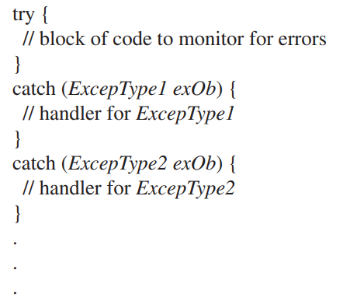
At the core of exception handling are try and catch.
These keywords work together; you can’t have a catch without a try.
Here is the general form of the try/catch exception handling blocks:

Slide 8

Here is a simple example that illustrates how to watch for and catch an exception.
As you know, it is an error to attempt to index an array beyond its boundaries.
When this occurs, the JVM throws an ArrayIndexOutOfBoundsException.
The following program purposely generates such an exception and then catches it:

Slide 9
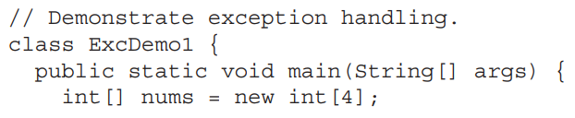
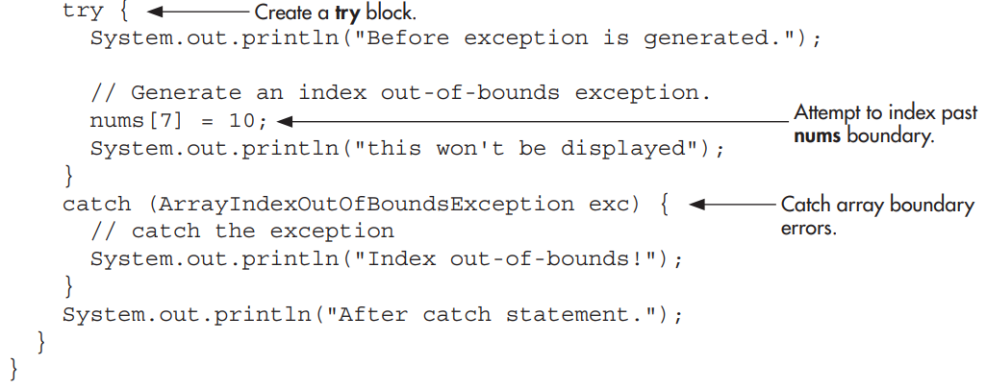

Slide 10

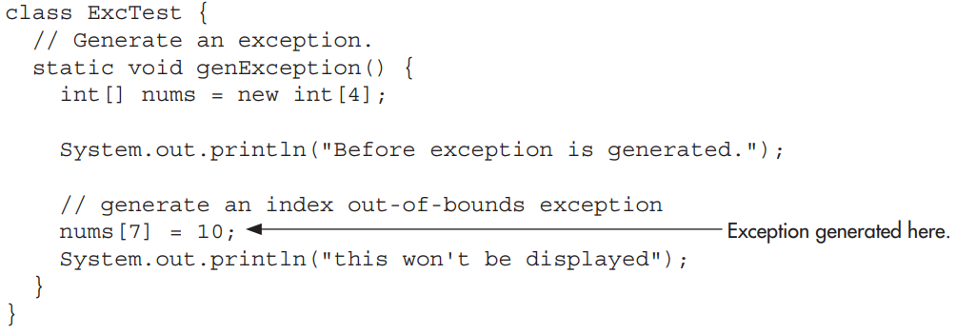

Slide 11
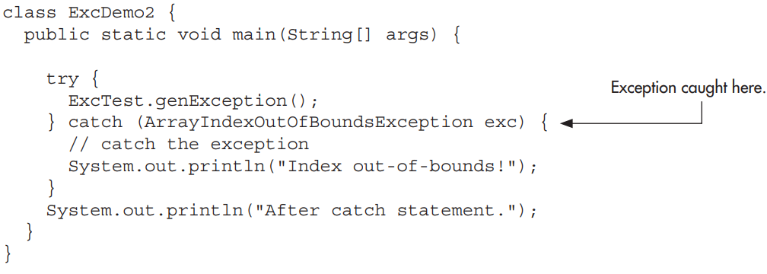

Slide 12
Catching one of Java’s standard exceptions, as the preceding program does, has a side benefit: It prevents abnormal program termination.
When an exception is thrown, it must be caught by some piece of code, somewhere.
When an exception is thrown, it must be caught by some piece of code, somewhere.
In general, if your program does not catch an exception, then it will be caught by the JVM.
The trouble is that the JVM’s default exception handler terminates execution and displays a stack trace and error message.

Slide 13
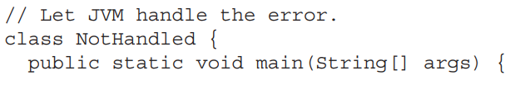
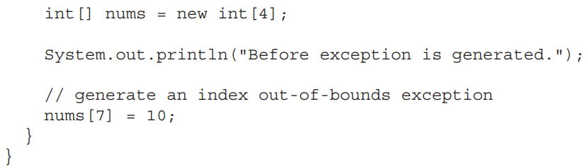
For example, in this version of the preceding example, the index out-of-bounds exception is not caught by the program.

Slide 14
When the array index error occurs, execution is halted, and the following error message is displayed. (The exact output you see may vary because of differences between JDKs.)

Slide 15
As mentioned earlier, the type of the exception must match the type specified in a catch statement.
If it doesn’t, the exception won’t be caught.
For example, the following program tries to catch an array boundary error with a catch statement for an ArithmeticException (another of Java’s built-in exceptions).

Slide 16
When the array boundary is overrun, an ArrayIndexOutOfBoundsException is generated, but it won’t be caught by the catch statement.
This results in abnormal program termination.

Slide 17
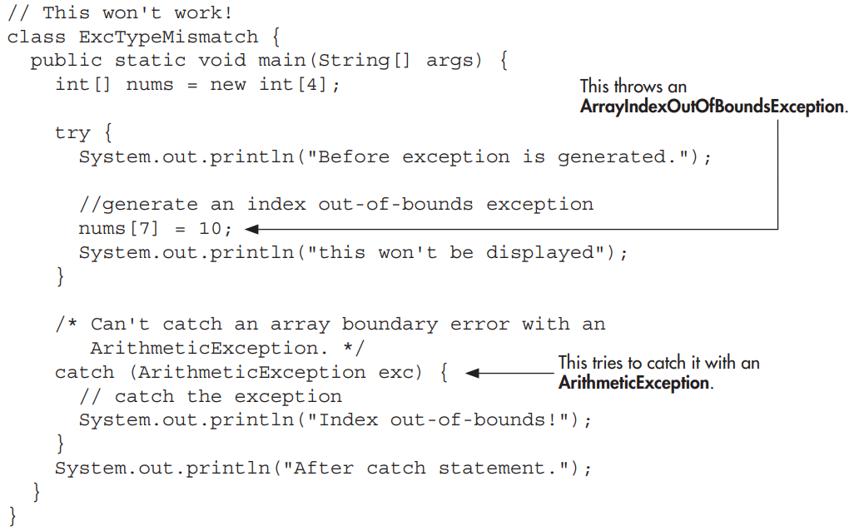

Slide 18
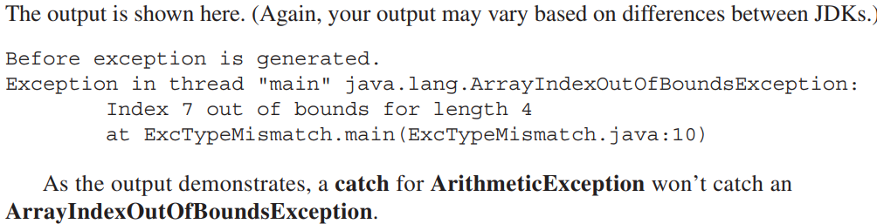

Slide 19
One of the key benefits of exception handling is that it enables your program to respond to an error and then continue running.
For example, consider the following example that divides the elements of one array by the elements of another.
If a division by zero occurs, an ArithmeticException is generated.
In the program, this exception is handled by reporting the error and then continuing with execution.

Slide 20
Thus, attempting to divide by zero does not cause an abrupt run-time error resulting in the termination of the program.
Instead, it is handled gracefully, allowing program execution to continue.

Slide 21
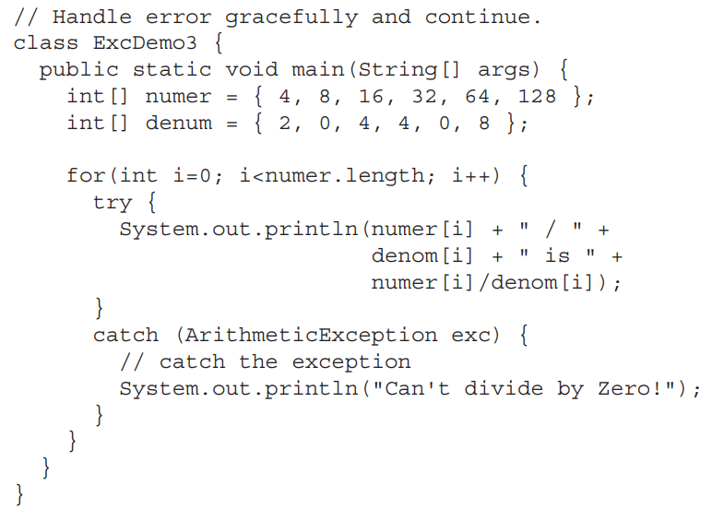

Slide 22
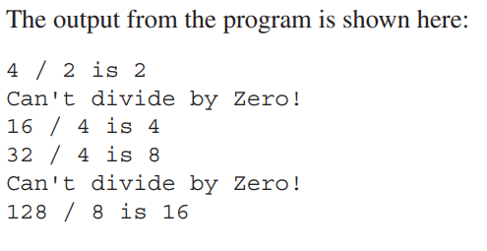

Slide 23
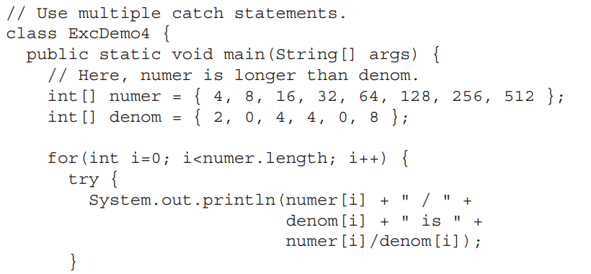

Slide 24
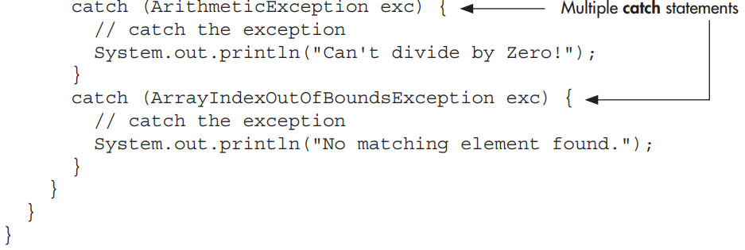

Slide 25
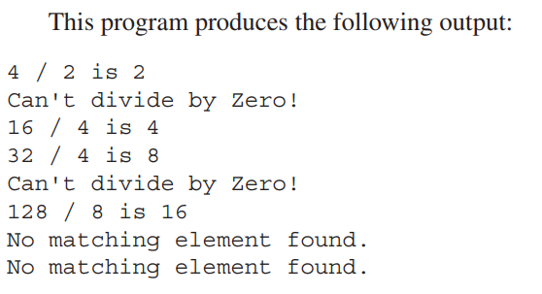

Slide 26

There is one important point about multiple catch statements that relates to subclasses.
A catch clause for a superclass will also match any of its subclasses.
For example, since the superclass of all exceptions is Throwable, to catch all possible exceptions, catch Throwable.

Slide 27
If you want to catch exceptions of both a superclass type and a subclass type, put the subclass first in the catch sequence.
If you don’t, then the superclass catch will also catch all derived classes.
This rule is self-enforcing because putting the superclass first causes unreachable code to be created, since the subclass catch clause can never execute.

Slide 28
In Java, unreachable code is an error.

Slide 29
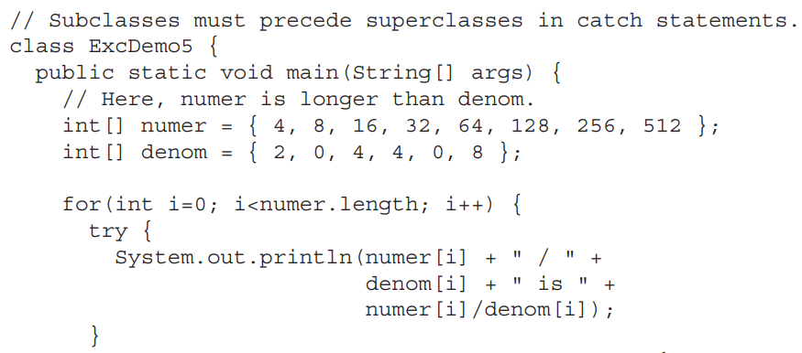

Slide 30
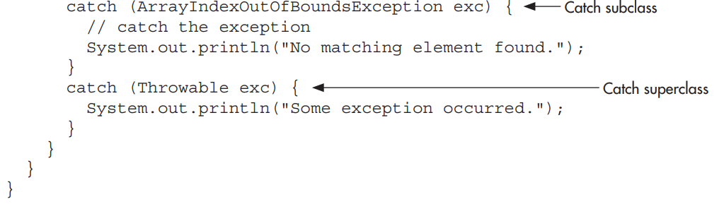

Slide 31
